Slide 1
OFFICE SUPPLIES MANAGEMENT
SYSTEM
SUPERVISOR : Mrs Nuwandi Madushani
Faculty of Information Technology
Genaral Sir John Kotelawala Defence University

Slide 2
Group Members
IS/16/009 R.L Wijewardhana
IT/16/019 K.C Ediriweera
IT/16/024 M.S.D Fernando

Slide 3
overview
Aim
Intention of the project
Requirements
Technology

Slide 4
AIM
The aim of this project is to build an OSMS that improves the flexibility of the internal communication regarding to various tasks done in KDU by employees. (In Departments)

Slide 5
Intention of this project
In the present system
there is no comprehensive method to keep tracks.
In present system environment where the number of jobs is done simultaneously is a difficult task its Because the lack of skills of the person. So it may be reason to loss the information.
In Office supplies management system
by introducing a OSMS it can keep track of the number of tasks completely .
Can easily update the tasks.
Have better way to monitor things.
Therefore, there is a timely need for a simplified web based system for KDU to handle their internal communications related to various tasks.

Slide 6
Functional Requirements
Create administration accounts for various access levels such as Rector, Dean, Faculty Deans, Head of the Departments, Registrar.
User Interface contains a login page by which a user can log with appropriate access to tasks.
Users can create a new order, check orders, forward orders, remove orders, edit and monitor order.
User is always associated with orders. So user can always visualize the entire database and easy to store data.
Admin can see the progress of the whole system when he log into Admin page
User gets the notifications when there is any updating.
System should be applied better encoding algorithm on behalf of the secure of the system.
System should provide reports for the users.
Keep track on the network failures.
System should be kept backups for the unavoidable situations

Slide 7
Non-functional Requirements
The system should accurately provide real time information taking into consideration various concurrency issues.
Quick and easy access to the web server in order to store and retrieve data. And this will make sure the maximum usability of OSMS.
Can access to the data at anytime from anywhere.

Slide 8
Technology
Photoshop
Dreamweaver
Visual Studio
PHP my admin

Slide 9
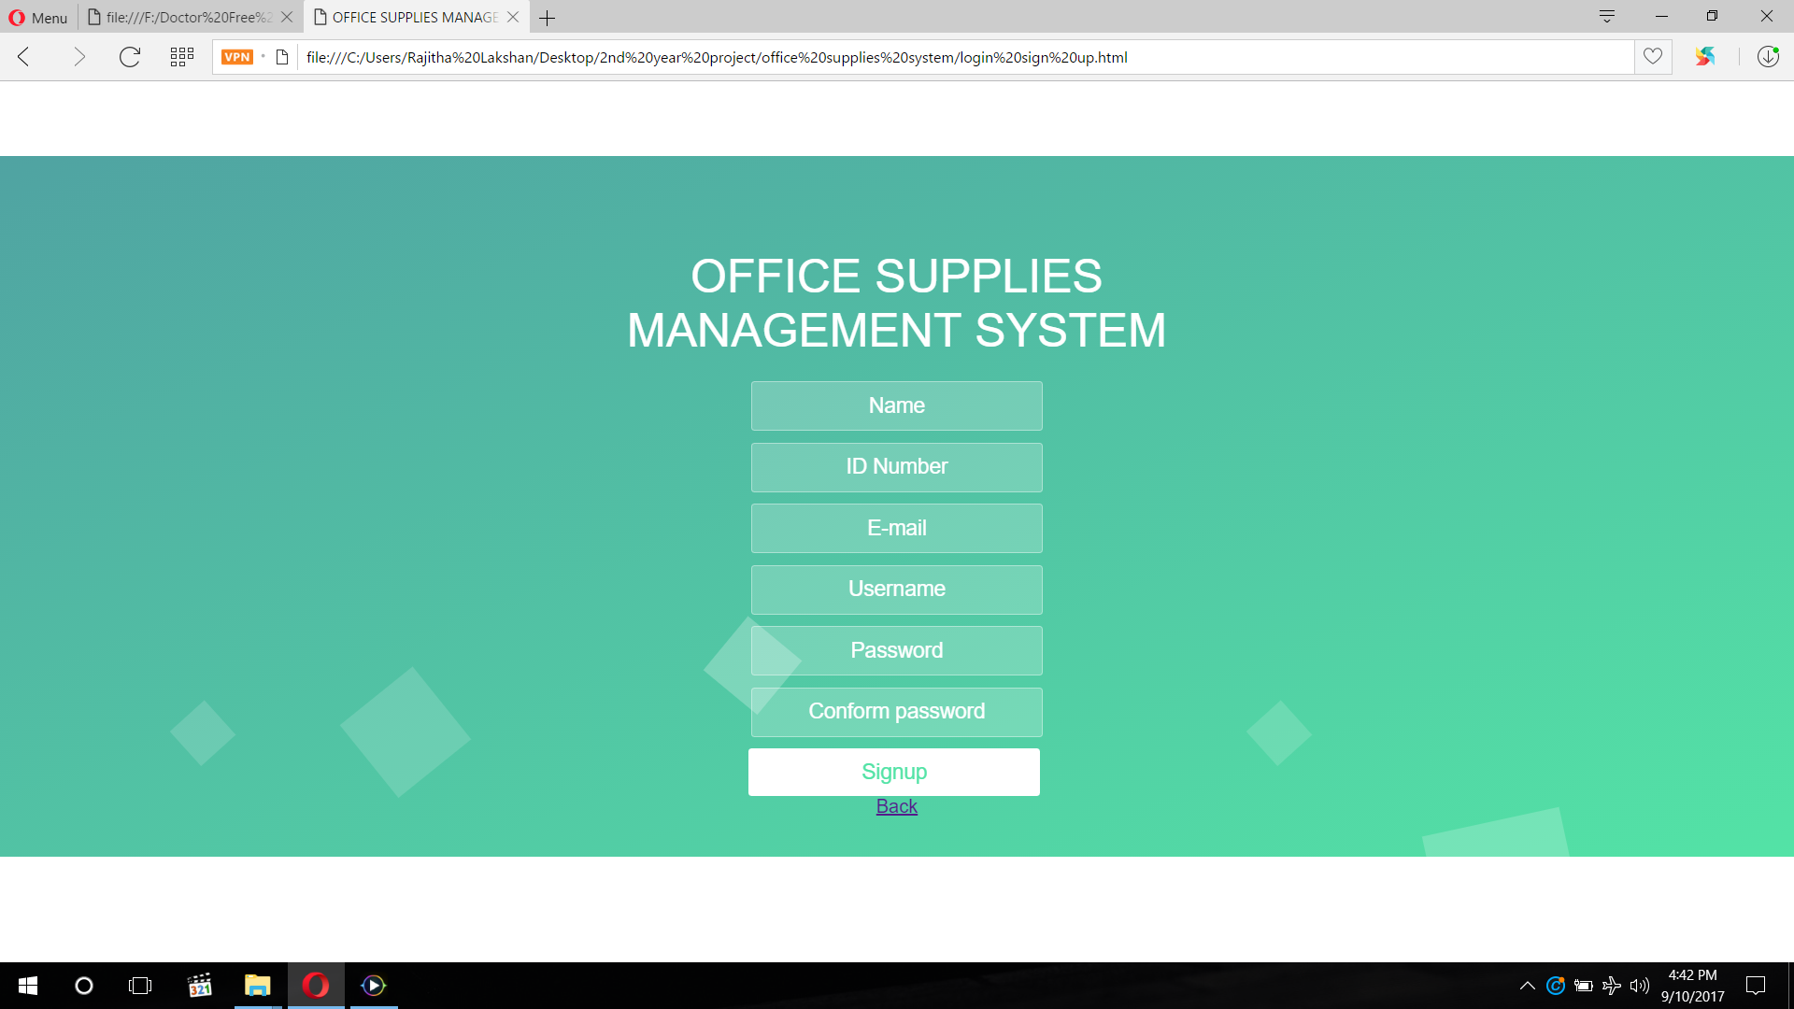
Interfaces

Slide 10
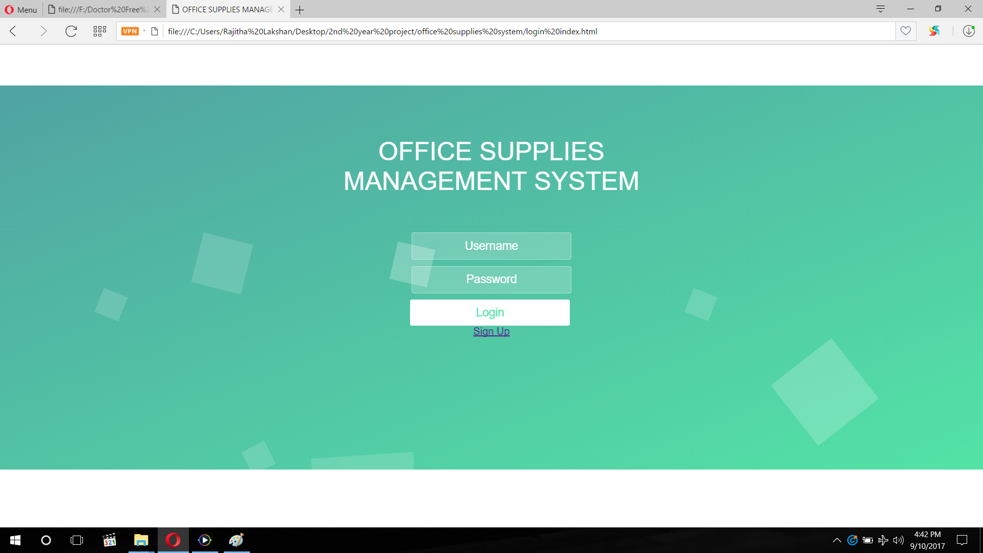

Slide 11
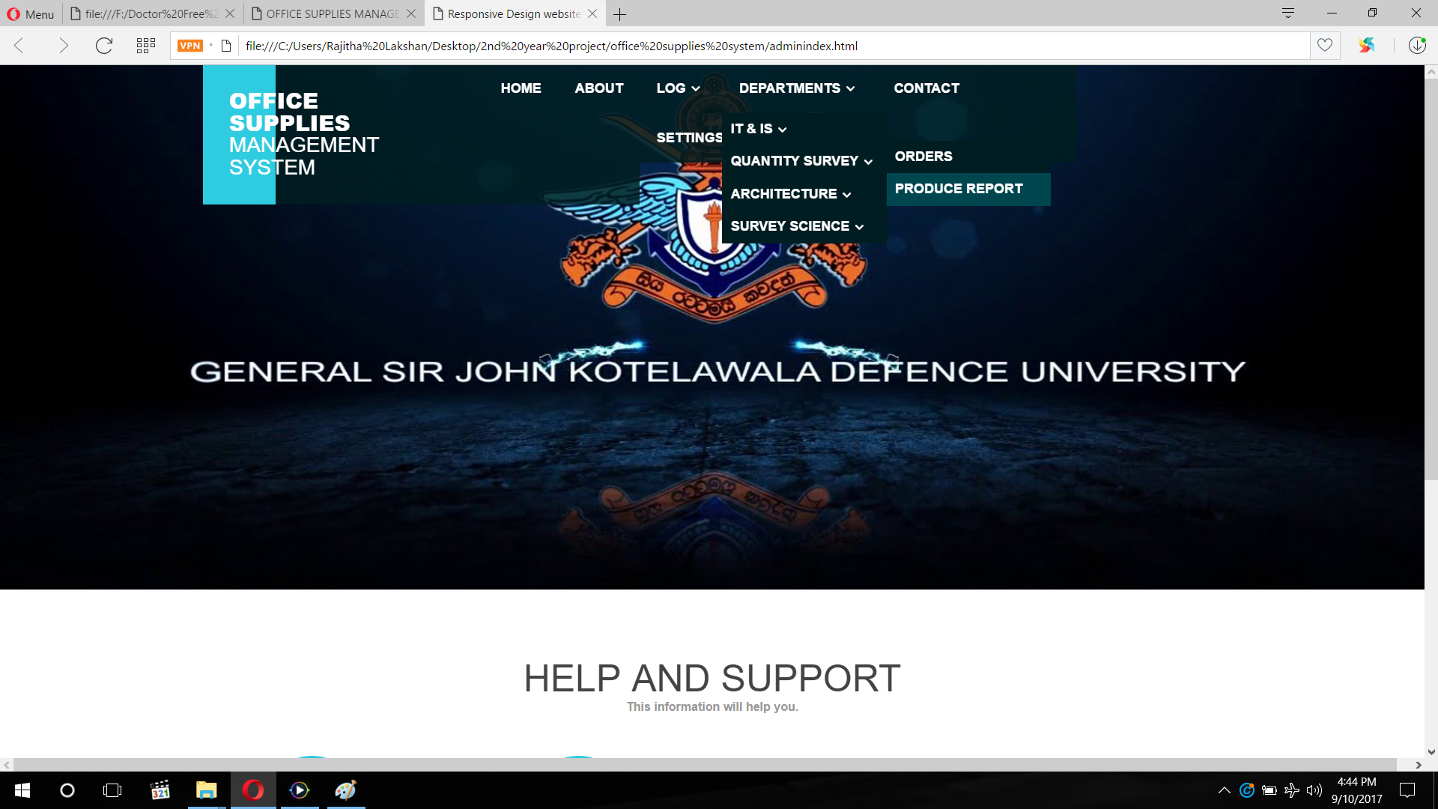

Slide 12
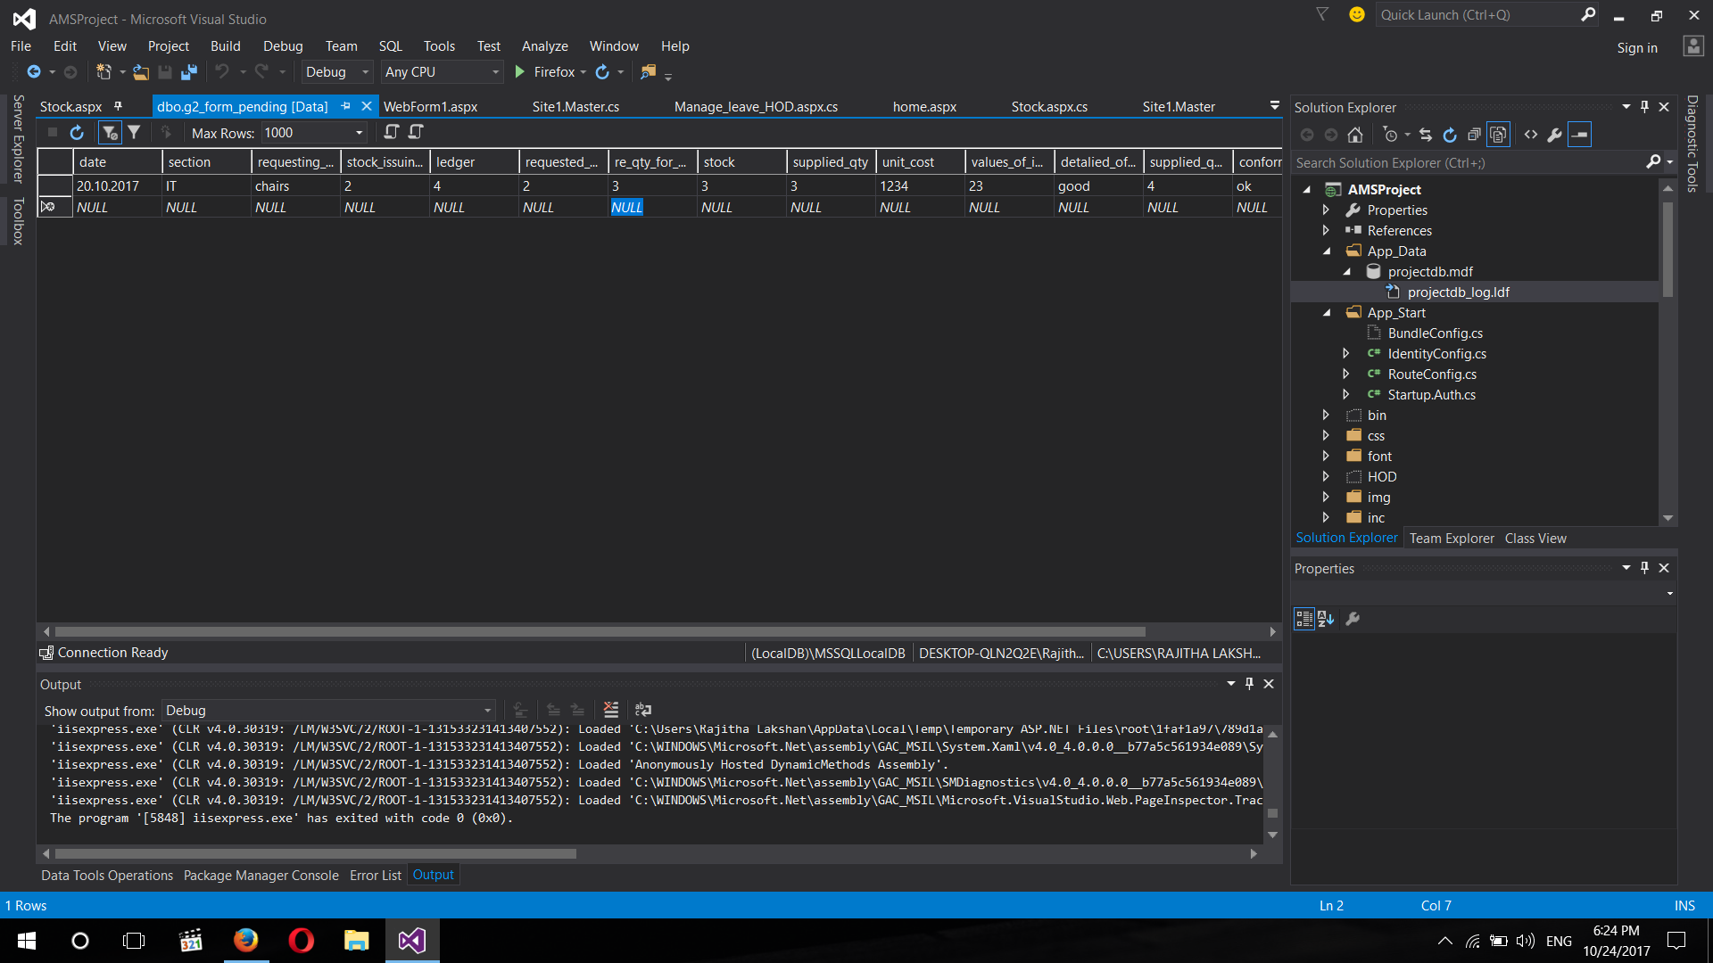
TABLE OF
G2 FORM

Slide 13
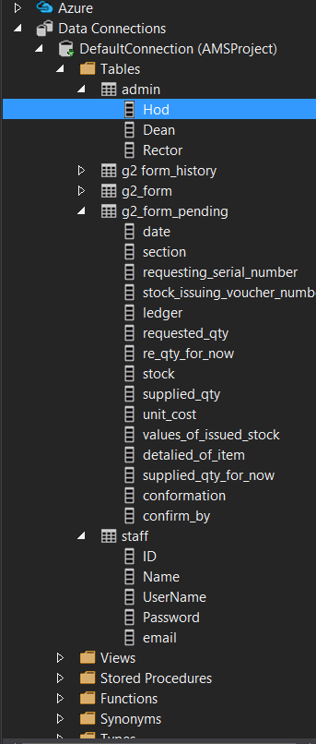
TABLES

Slide 14
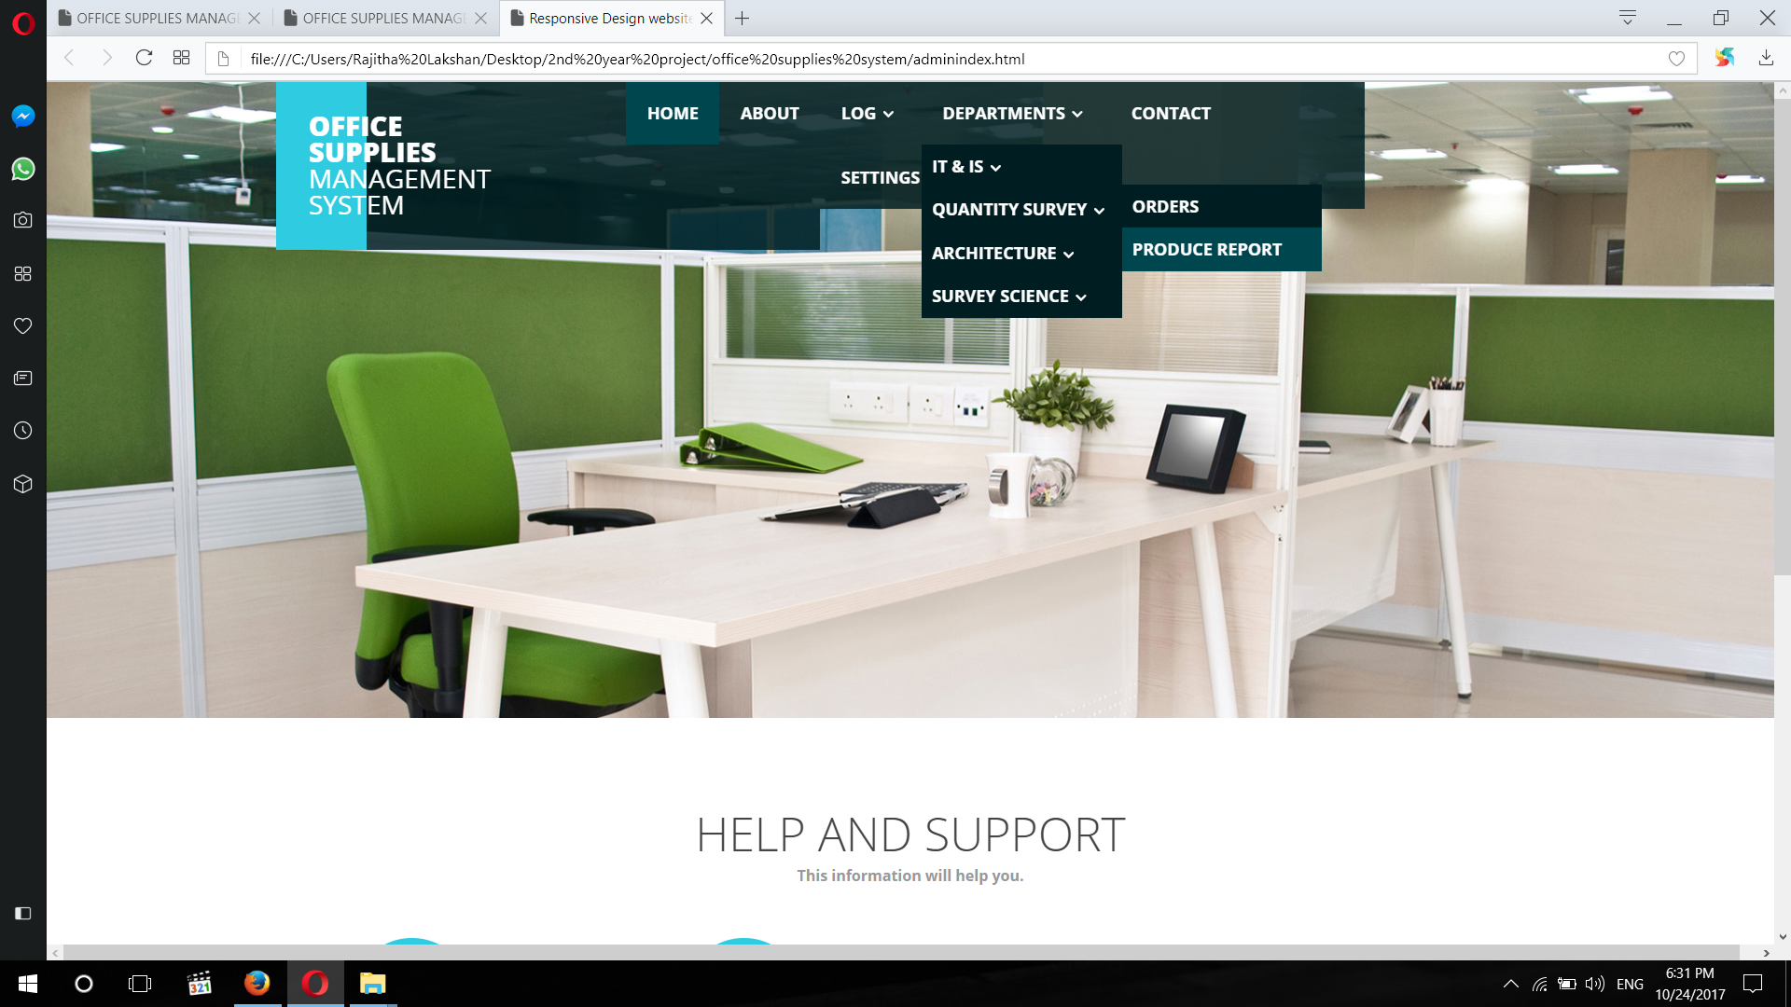

Slide 15
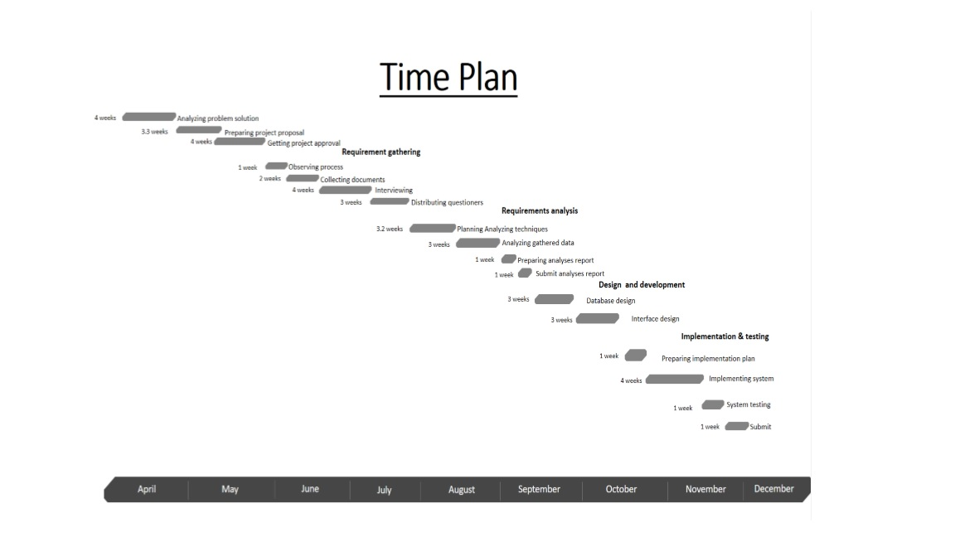
Time plan

Slide 16
THANK YOU

